Slide 1
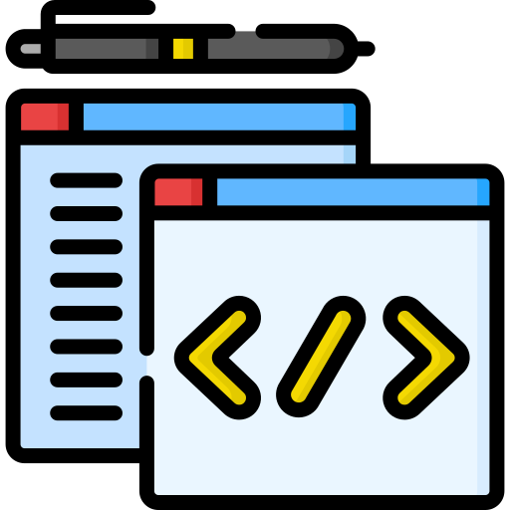

Mocking J[ava]
x
a.png
x
b.png
with Mockito
Red
Gayle

Slide 2
Red
x
a.png
x
b.png
Gayle

Slide 3


x
Goal.jpg
x
a.png
x
b.png
x
Ovrvw.txt
Unit Testing
What is Mocking
Why Mock
When to Mock
DEMO (Mockito)
Red
Gayle

Slide 4

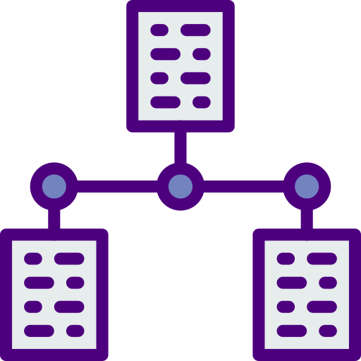


x
Goal.jpg
x
Ovrvw.txt
What is Mocking
Why Mock
When to Mock
DEMO (Mockito)
Notes:
Background :

Slide 5
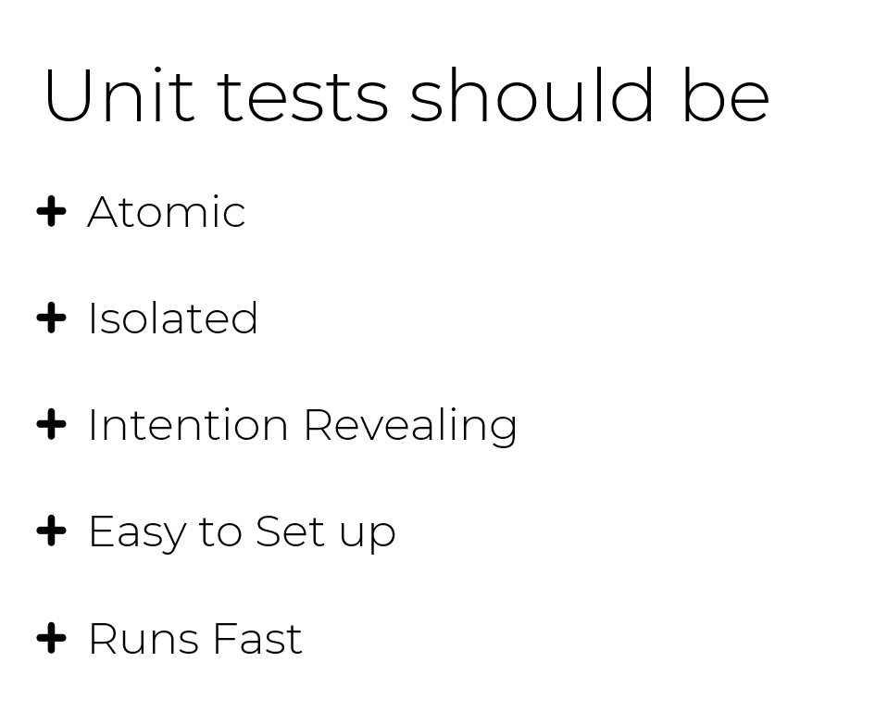

x
Tips.txt
x
art.png
Unit tests should be
Atomic
Isolated
Intention Revealing
Easy to Set up
Runs Fast

Slide 6

x
Tips.txt
x
Tips.txt
Wait, but what
is Mocking really?
x
art.png
x
help.png
Notes:
Single Responsibility Principle (SRP)

Slide 7
x
Tips.txt
Wait, but what
is Mocking really?
x
help.png

Slide 8
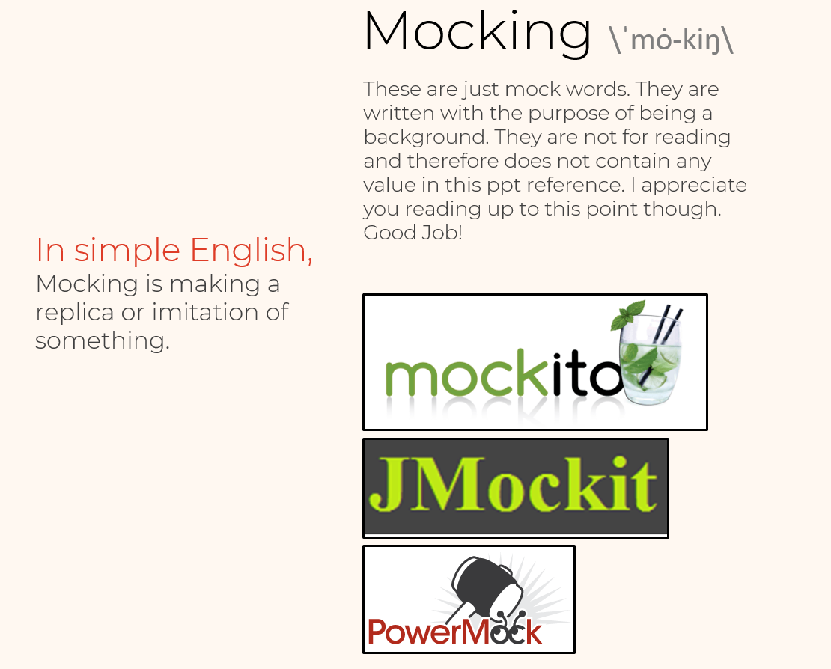
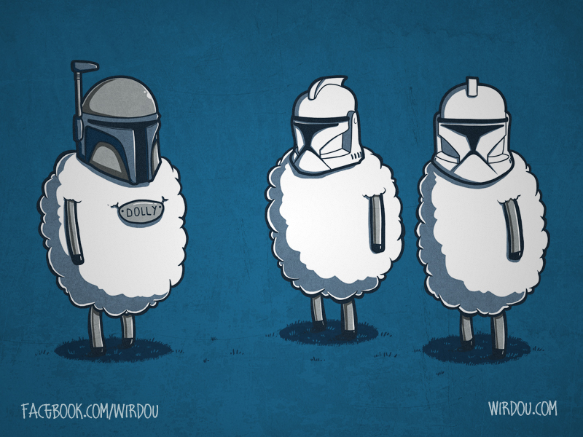
x
wat.html
x
define.txt
> In OOP, mock objects are
> simulated objects that
> mimic the behavior of real
> objects in controlled ways.
x
Tips.txt
Wait, but what
is Mocking really?
x
help.png

Slide 9
x
wat.html
x
define.txt
> Mocking is primarily used in
> unit testing
>
> We use Mocking
> Frameworks or APIs such as
> Mockito and Jmockit to
> help us achieve our goal

Slide 10

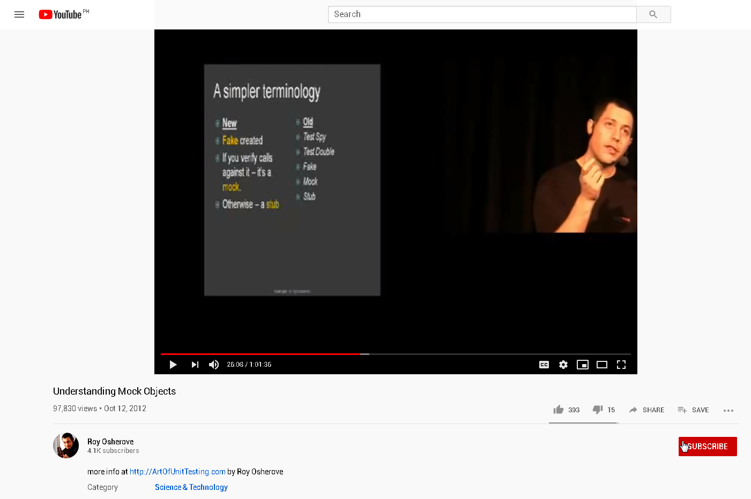
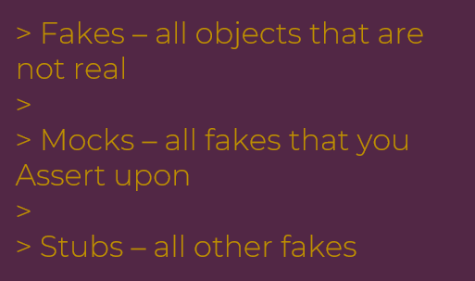
x
x
wat.html
aaaaaask.bat
x
define.txt
So, when do we mock?

Slide 11

x
art.png
x
aaaaaask.bat
x
x
wat.html
Tips.txt
When to use Mocking?
x
define.txt
> Fakes – all objects that are not real
>
> Mocks – all fakes that you Assert upon
>
> Stubs – all other fakes
The real object has nondeterministic behavior
The real object is difficult to setup
The real object has behavior that is hard to trigger
So, when do we mock?

Slide 12
x
Tips.txt
When to use Mocking?
x
art.png
The real object has nondeterministic behavior
The real object is difficult to setup
The real object has behavior that is hard to trigger

Slide 13
x
Tips.txt
When to use Mocking?
x
art.png
The real object is slow
The real object does not yet exist

Slide 14


x
art.png
In unit testing we want to test methods of one class in isolation. To do this, we mock the services and methods from other classes.
x
Tips.txt
x
art.png
x
Tips.txt
When to use Mocking?
x
art.png
The real object is slow
The real object does not yet exist

Slide 15
x
art.png
x
Tips.txt
DEMO
x
art.png
x
art.png

Slide 16
x
art.png
x
Tips.txt
x
art.png
DEMO
x
art.png

Slide 17
x
Tips.txt
x
art.png
x
art.png

Slide 18
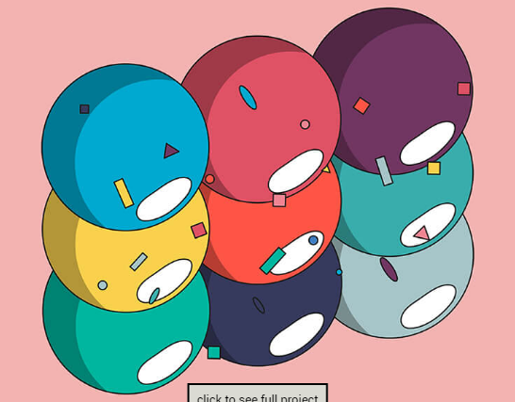
x
wat.html
Exercise:
Given:
Waiter – can take, repeat, relay, follow-up, and serve Order
Cook – can read, cook, and plate Order
Pair up! You may leave current call to pair with someone BUT keep your chats open when I ask you to come back to main meeting call after N minutes
Complete/Add the remaining tests for WaiterTest and CookTest
x
Tips.txt
x
art.png
x
art.png

Slide 19
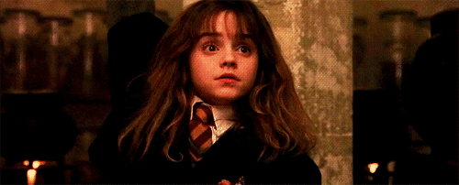
x
art.png
Any Questions?

Slide 20

REFs & RECOs
x
art.png
x
refs.txt
The Art of Unit Tests
Roy Osherove
tutorialspoint.com/mockito/index.htm
https://java2blog.com/mockito-example/
Mockito for Unit Test
Sunny Wu
Icons and Art from marianopascual.me & flaticon.com

Slide 21
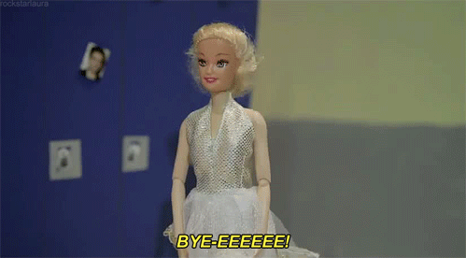
Presentation by: Gayle Bituin
x
art.png

Slide 22
OPS hindi pa tapos wait langz

